Slide 1
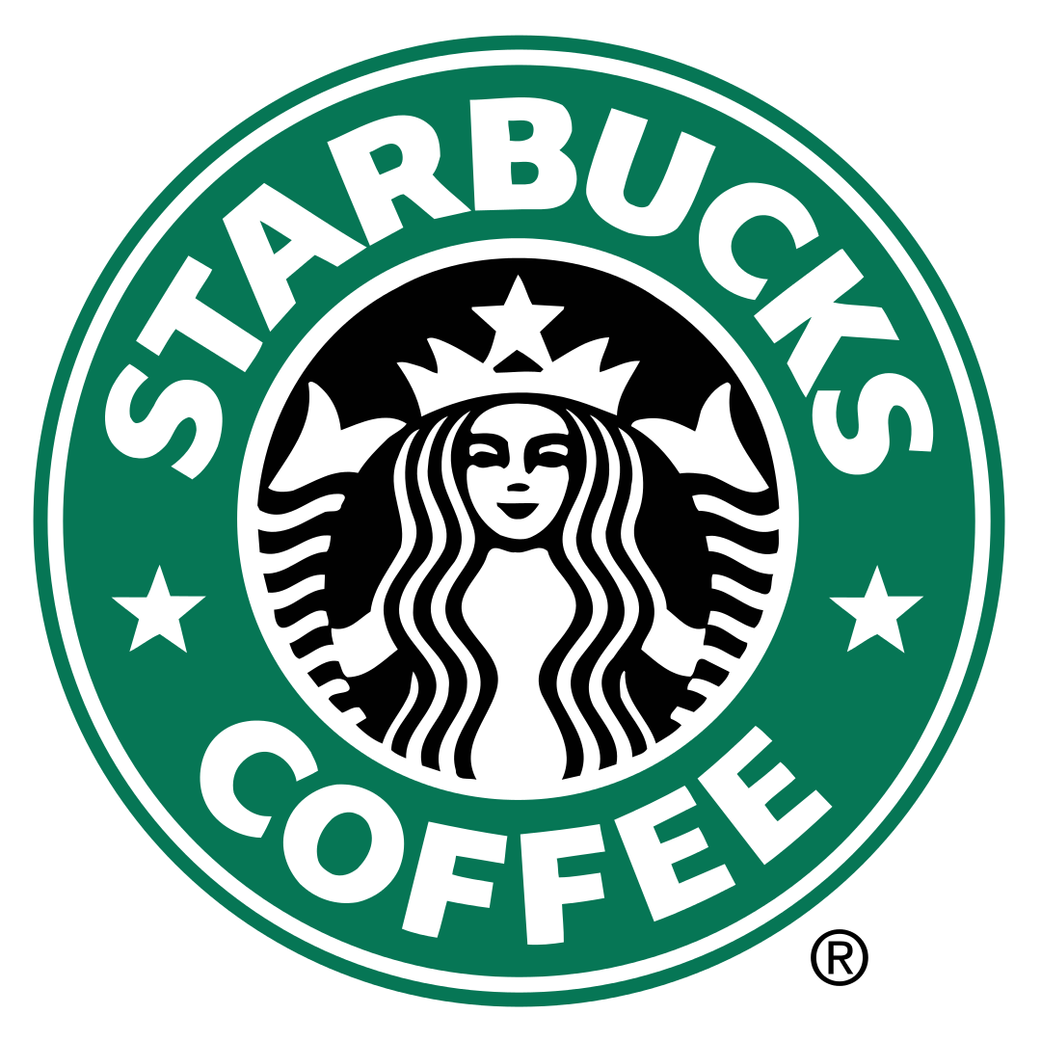
Starbucks Menu and Nutrition
By: Reno Sholeh

Slide 2




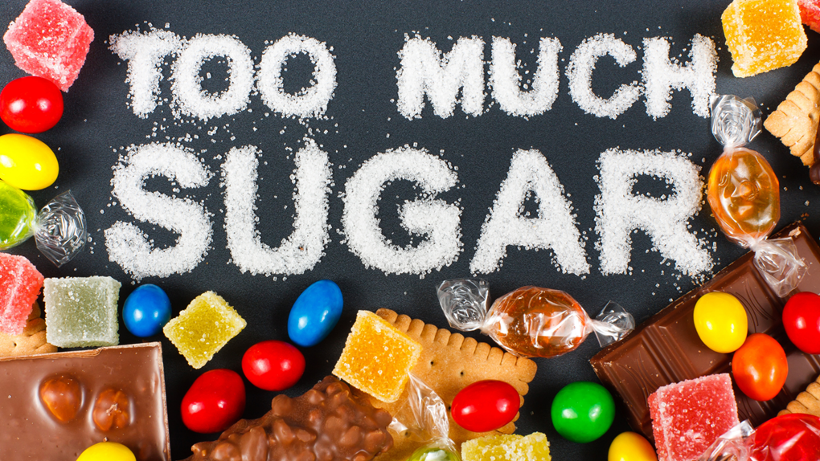
The Problem
Everyone who knows and loves coffee usually goes to Starbucks as their daily driver. Little do they know they are getting drinks that are overloaded with sugars, sodium, and caffeine.
If we took a deeper look at what actually makes up their drinks, one would be blown away at the nutritional values.

Slide 3


Benefits
Find places where Starbucks can improve on providing better nutritional value to customers.
Gives consumers like you an insight on what you’re buying and putting in your body.

Slide 4

Methodology
I was able to break the problem down by analyzing the data by the nutritional values like Calories, Fat (g), and Sodium (g). This helped me find things like the distribution of calories across the entire menu.
The tools that I used for this were Pandas, Seaborn, and Matplotlib. I personally really enjoyed using the Seaborn package as it really gives your data nice visuals.
Some of the challenges that I had was when I had to get the visualizations working. I had many times where I was greeted with output errors but they were due to small input mistakes and was quickly figured out. Another was just getting packages to work as some didn’t work on a specific version of python, so I had to switch that.

Slide 5
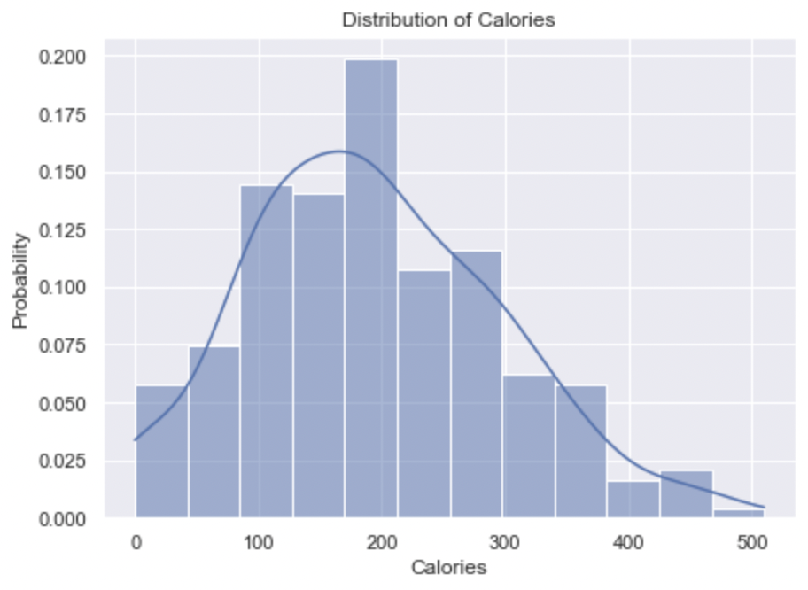
Findings/Insights
Was able to find things like the distribution of calories across the entire menu. As you can see within the menu there are many items that are within the 200 calories range which isn’t too bad.

Slide 6
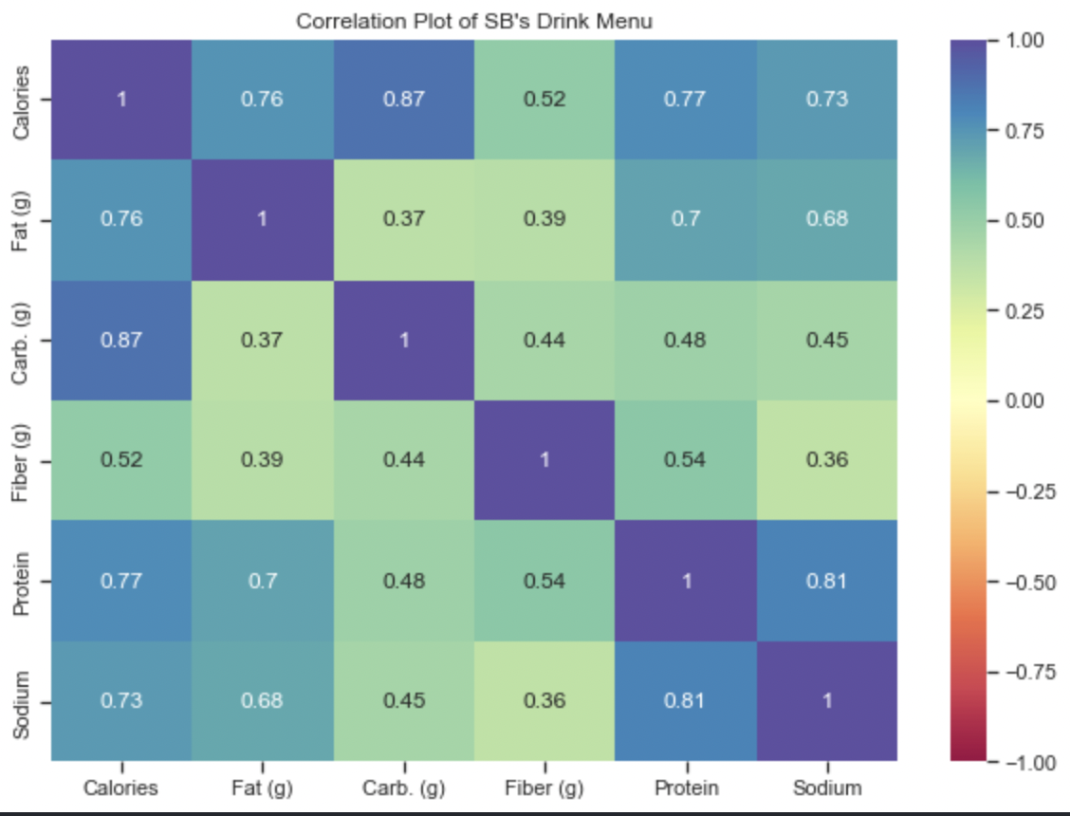
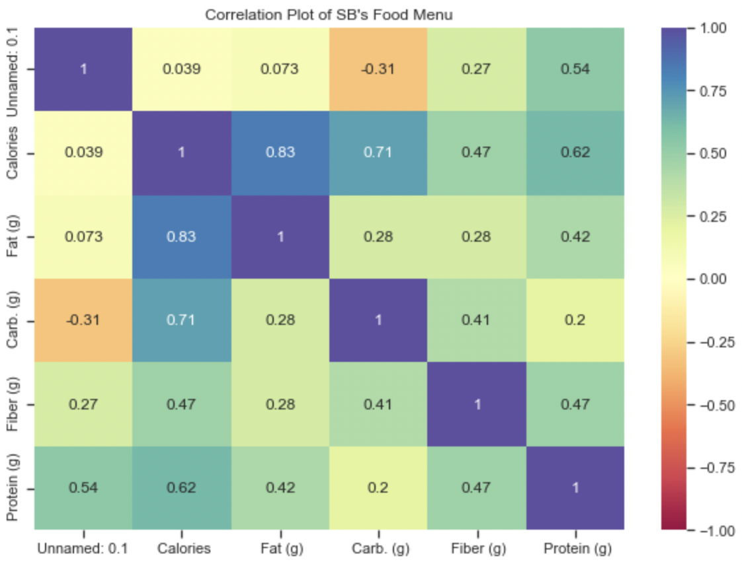
Findings/Insights
Another finding I came across was the correlation between the nutritional values within their Drink and Food menu’s.
As you can see from the visuals, some insights we are able to gain are how Carbs + Calories, Fat + Calories and Sodium + Protein are some of the things that have high correlation between each other.

Slide 7
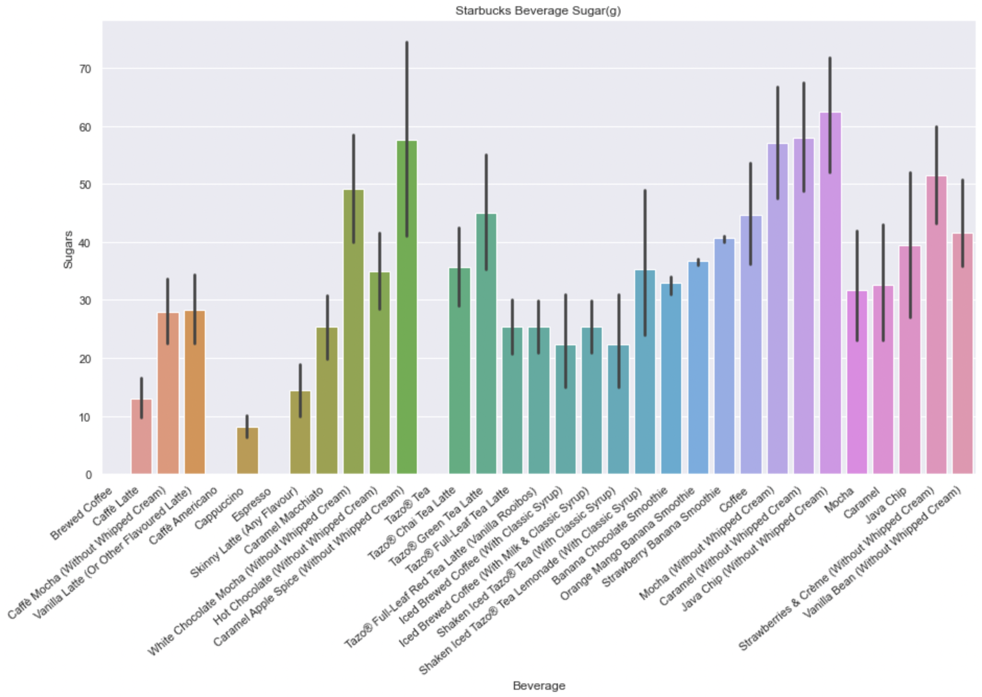
Findings/Insights
From this visual we are able to see the drinks that contain the highest amount of sugars.
The top three would be the Java Chip (without whipped cream), Caramel Apple Spice (without whipped cream) and Caramel (without whipped cream) all hovering around 60g of sugar.
That’s a lot of sugars! To put it into perspective try eating 5 tablespoons of sugar.

Slide 8
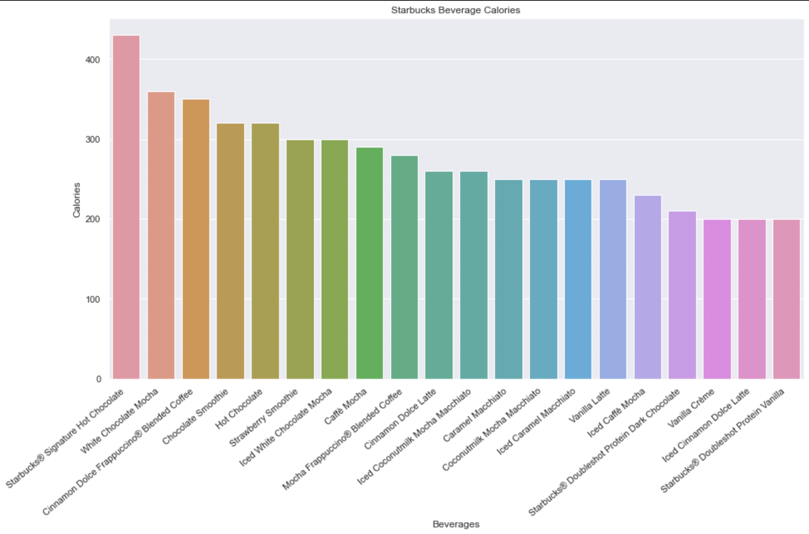
Findings/Insights
From this visual we are able to see the top 20 Starbucks beverages with the highest amount of calories.
We have the Signature Hot Chocolate in 1st with a whopping 400 calories just in a drink. With White Chocolate Mocha coming in 2nd and Cinnamon Dolce Frap in 3rd hovering around 350 calories.

Slide 9
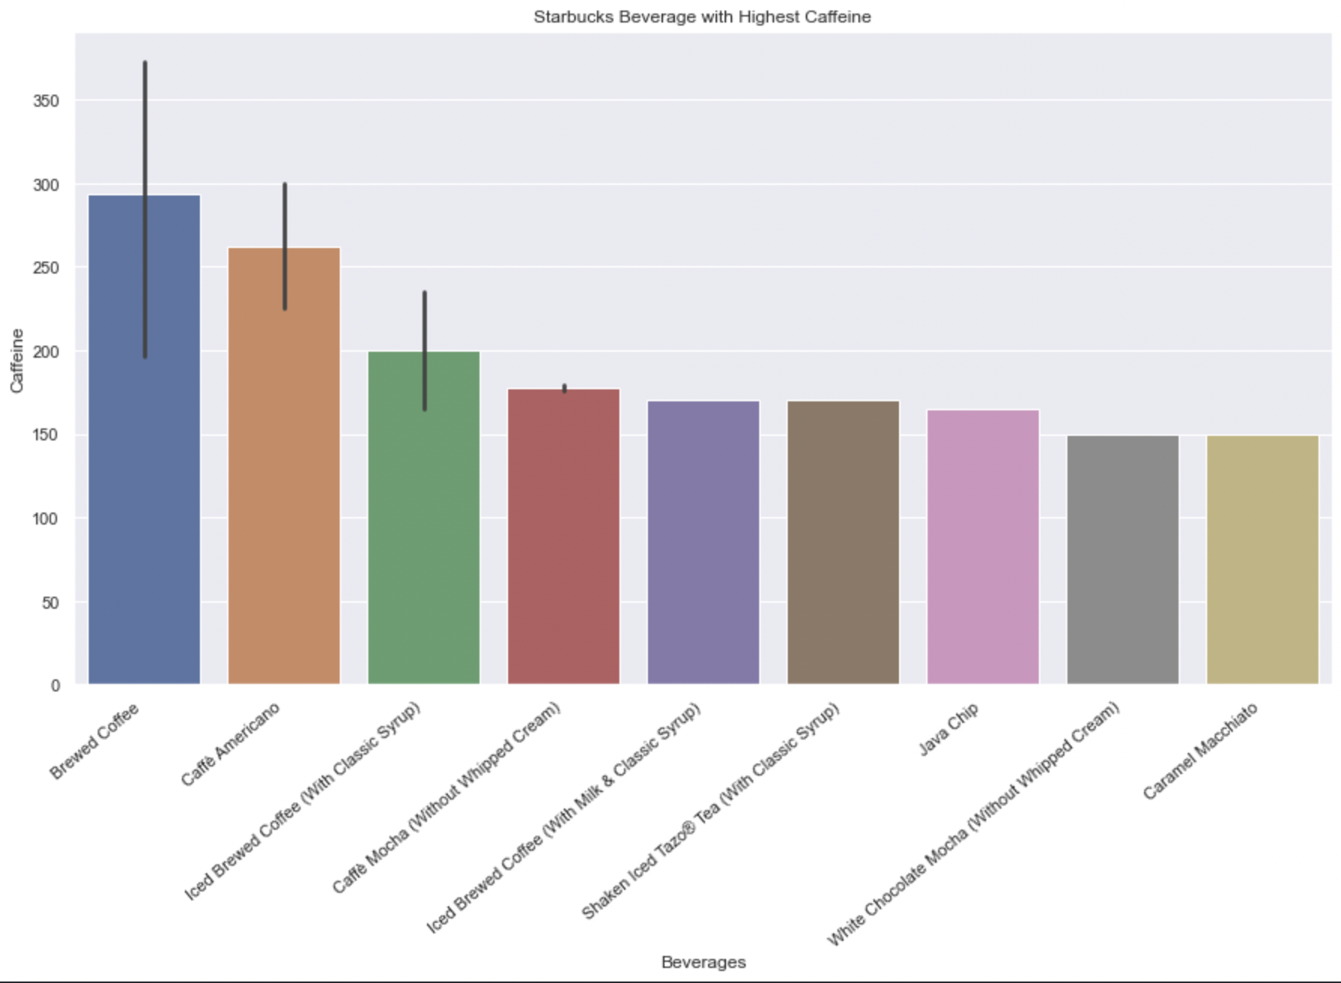
Findings/Insights
Through this visual I was able to see what drink contains the highest amount of caffeine in it. That drink being a normal Brewed Coffee with almost 300mg of caffeine!
When you compare it to something like a Monster with about 86mg of caffeine, it really shows how much is packed inside such a small drink

Slide 10

Recommendations
One of my first recommendations to make would be to reevaluate the drinks that contain the highest amount of sugars and to try to bring it down lower without sacrificing quality.
Another recommendation would be to look into creating a menu catering towards healthier options when it comes to drinks and food. Maybe something like more smoothie options.

Slide 11

Future Work
I believe that this problem can definitely be revisited in the future. I was only able to get data that I understood how to do whereas someone that is more experienced would be able to pull deeper insights from the data.
This project could very much be improved with more work as I didn’t do it in the most organized way. If I was given more time/resources I would’ve been able to organize my code a bit better as well as understand the ML portion more.

